Slide 1
ECOMMERCE DELIVERY ANALYSIS DASHBOARD
Present By
Kalaiyarasi S

Slide 2
Introduction
Ecommerce platforms depend heavily on fast and reliable delivery.
Customer satisfaction directly impacts business growth.
This project analyzes delivery performance and customer feedback using Power BI.

Slide 3
Problem Statement
Businesses face challenges such as:
Delivery delays,
Customer dissatisfaction,
High refund requests,
Platform performance comparison,
The goal is to identify key operational issues using data analytics.

Slide 4
Objectives
Analyze delivery performance.
Compare ecommerce platforms.
Track customer ratings and feedback.
Identify refund trends.
Improve operational efficiency.

Slide 5
Tools & Technologies
Tools Used.
Power BI.
Microsoft Excel.
Data Visualization Techniques.
Data Cleaning & Transformation.

Slide 6
Dataset Details
The dataset contains:
Order details
Delivery time
Product categories
Customer ratings
Refund information
Platform information
Total records analyzed: 100K+

Slide 7
Data Cleaning Process
Data Preparation Steps:
Removed duplicate values,
Handled missing data,
Standardized category names,
Converted data types,
Created calculated measures,

Slide 8
Dashboard Overview
Dashboard Components:
KPI Cards
Pie Chart
Line Chart
Bar Chart
Interactive Slicers
Key metrics displayed:
Average Delivery Time
Total Orders
Service Ratings
Refund Trends

Slide 9
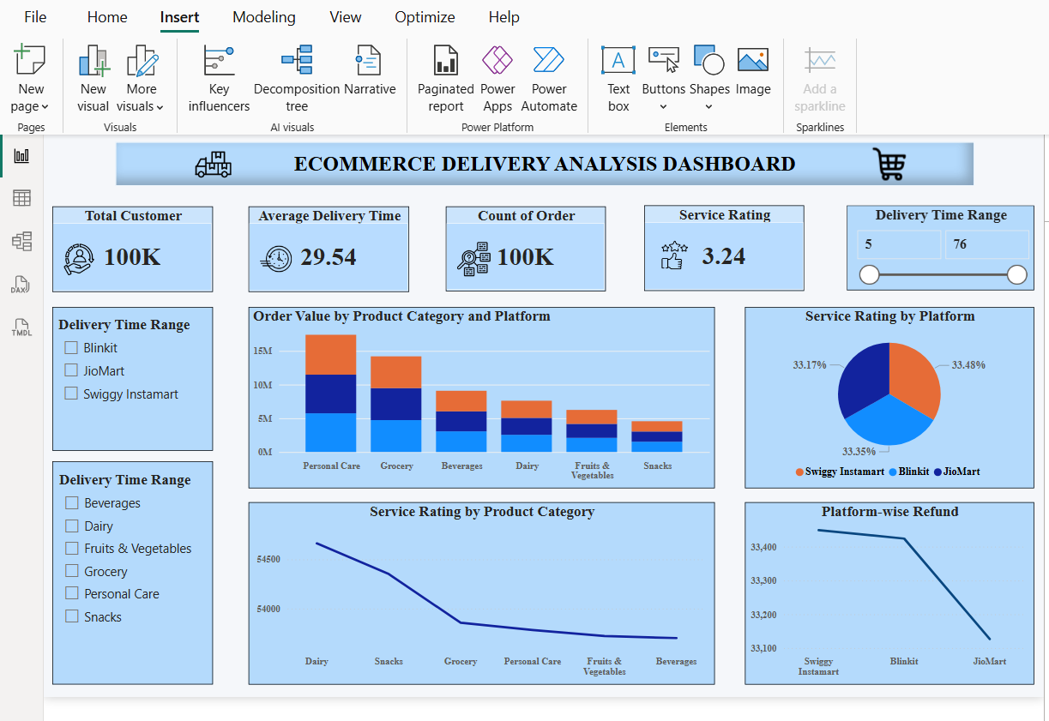

Slide 10
KPI Analysis
KPI Insights
Total Customers: 100K
Average Delivery Time: 29.54 Minutes
Total Orders: 100K
Average Service Rating: 3.24
These KPIs provide a quick overview of operational performance.

Slide 11
Product Category Analysis
Product Category Insights.
Personal Care generated the highest order value.
Grocery and Beverages showed strong sales.
Some categories experienced lower service ratings.

Slide 12
Platform Performance Analysis
Platform Comparison
Compared platforms:
Blinkit,
JioMart,
Swiggy Instamart.
Analysis based on:
Service ratings
Refund requests
Delivery performance

Slide 13
Refund Analysis
Refund Request Insights.
Delayed deliveries increased refund requests.
Some platforms had higher refund percentages.
Operational improvements can reduce refund losses.

Slide 14
Customer Satisfaction Analysis
Customer Feedback Analysis:
Faster deliveries improved ratings.
Negative feedback was linked to:
Late deliveries.
Missing items
Wrong item delivery

Slide 15
Business Benefits
Business Impact:
This dashboard helps organizations
Improve delivery efficiency
Reduce operational issues
Increase customer retention
Make data-driven business decisions

Slide 16
Future Enhancements
Future Scope
Real-time dashboard updates
AI-based delivery prediction
Sentiment analysis on customer feedback
Integration with cloud databases

Slide 17
Conclusion
The Ecommerce Delivery Analysis Dashboard successfully provides insights into delivery operations, customer satisfaction, and refund behavior.
The project demonstrates the power of Power BI in solving real-world business problems.

Slide 18
THANK YOU

